Slide 1
Código reactivo en JavaScript
Grupo 12
Integrantes:
Maximiliano Friedl Schwarzenberg
Tomás Mellado Medina
Noemí Crosby Conget

Slide 2
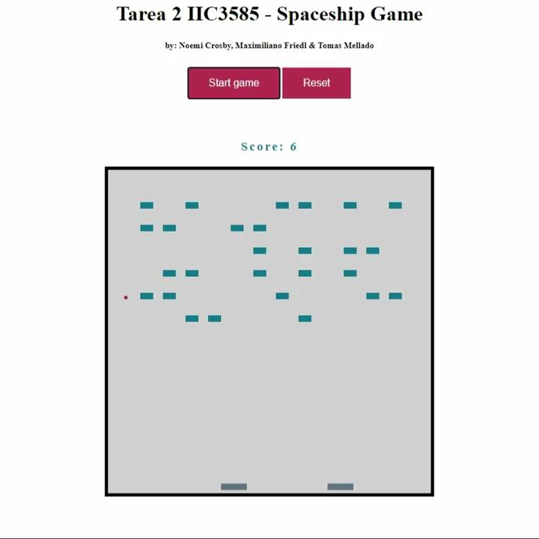
Demo

Slide 3
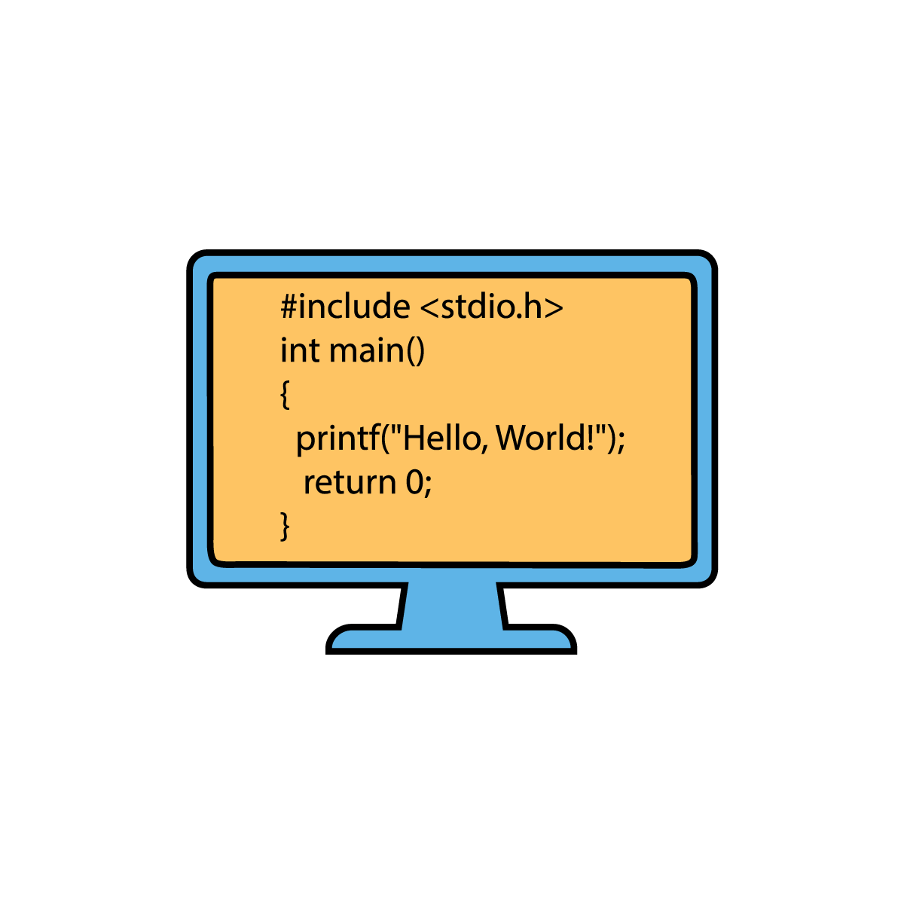
Lo más interesante de nuestro código

Slide 4
Recibir Comandos
var keyDowns = Rx.Observable.fromEvent(document, 'keydown');
keyDowns.subscribe(function (e) {
...
if (e.key === 'ArrowLeft' && playerInBoard(2, 'l')) {
state.board.updatePlayer(2, 'l');
state.player2.x -= 1
} else if (e.key === 'ArrowRight' && playerInBoard(2, 'r')) {
state.board.updatePlayer(2, 'r');
state.player2.x += 1;
}
});

Slide 5
Recibir Comandos
var keyDowns = Rx.Observable.fromEvent(document, 'keydown');
V/S
var keyUp = Rx.Observable.fromEvent(document, 'keyup');

Slide 6
Recibir Comandos
var keyDowns = Rx.Observable.fromEvent(document, 'keydown');
keyDowns.subscribe(function (e) { … }

Slide 7
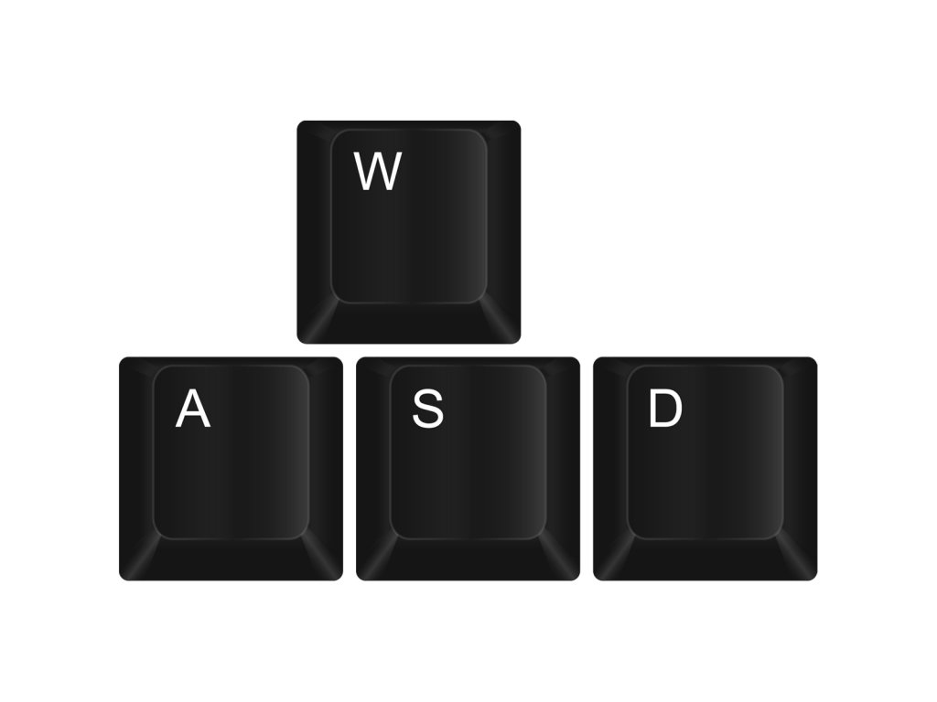
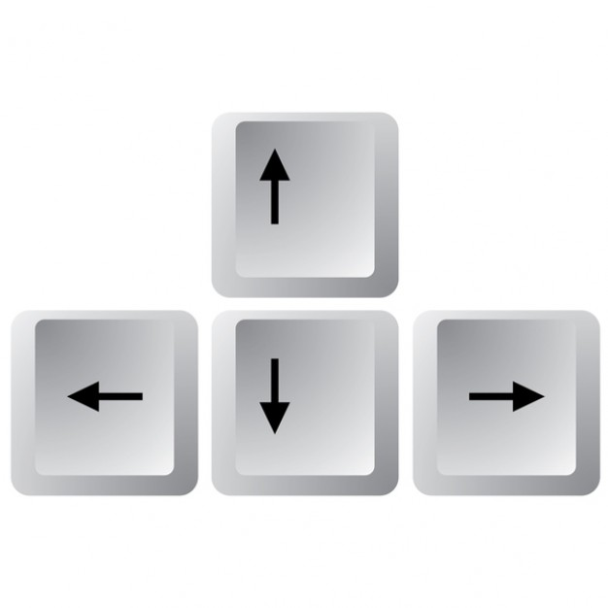
Recibir Comandos
var keyDowns = Rx.Observable.fromEvent(document, 'keydown');
keyDowns.subscribe(function (e) { … }

Slide 8
Recibir Comandos
var keyDowns = Rx.Observable.fromEvent(document, 'keydown');
keyDowns.subscribe(function (e) { … }

Slide 9
Interval
document.getElementById("start-button").onclick = function () {
const loop = Rx.Observable.interval(50);
loop.subscribe(() => {
if (state.blocks.length === 0 || state.ball.y + 1 === boardSize - 1) {
document.getElementById('end').innerHTML = 'GAME OVER';
loop.unsubscribe();
} else {
moveBall();
state.board.updateBall(state.ball.x, state.ball.y);
}
});
};

Slide 10
Interval
const loop = Rx.Observable.interval(50);
loop.subscribe(() => { … });

Slide 11

Interval
const loop = Rx.Observable.interval(50);
loop.subscribe(() => { … });

Slide 12

Interval
const loop = Rx.Observable.interval(50);
loop.subscribe(() => { … });

Slide 13
Interval
const loop = Rx.Observable.interval(50);
loop.subscribe(() => {
if (state.blocks.length === 0 || state.ball.y + 1 === boardSize - 1) {
document.getElementById('end').innerHTML = 'GAME OVER';
loop.unsubscribe();
}
});

Slide 14
Interval
const loop = Rx.Observable.interval(50);
loop.subscribe(() => {
if (state.blocks.length === 0 || state.ball.y + 1 === boardSize - 1) {
document.getElementById('end').innerHTML = 'GAME OVER';
loop.unsubscribe();
}
});

Slide 15
Interfaz
export default class Board {
constructor() {...}
getElement(x, y) {...}
paintDot(x, y, color) {...}
initBoard() {...}
updatePlayer (player, direction) {...}
updateBall (x, y) {...}
drawBlock (x, y) {...}
deleteBlock (x, y) {...}
}

Slide 16

Interfaz
export default class Board {
constructor() {...}
getElement(x, y) {...}
paintDot(x, y, color) {...}
initBoard() {...}
updatePlayer (player, direction) {...}
updateBall (x, y) {...}
drawBlock (x, y) {...}
deleteBlock (x, y) {...}
}

Slide 17
Interfaz
export default class Board {
constructor() {...}
getElement(x, y) {...}
paintDot(x, y, color) {...}
initBoard() {...}
updatePlayer (player, direction) {...}
updateBall (x, y) {...}
drawBlock (x, y) {...}
deleteBlock (x, y) {...}
}
Game
logic

Slide 18
Posicionando bloques
const makePoints = ( n, minX, maxX, minY, maxY ) => {
while ( state.blocks.length < n ) {
var p = {
x: random(minX, maxX, block_length),
y: random(minY, maxY, block_height)
};
if (!inList(p)) state.blocks.push(p);
}
}

Slide 19
Posicionando bloques
minX, minY
maxX, minY
minX, maxY
maxX, maxY

Slide 20
Posicionando bloques
( x, y )
block_height
block_length

Slide 21
Posicionando bloques
const random = (first, last, step) => {
var r = Math.floor(Math.random()*(last - first)/step);
return r * step + first;
}
const inList = ( p ) => {
for ( var i = 0; i < state.blocks.length; i++ ) {
if ( state.blocks[i].x == p.x && state.blocks[i].y == p.y ) return true;
}
return false;
}

Slide 22
Posicionando bloques
const random = (first, last, step) => {
var r = Math.floor(Math.random()*(last - first)/step);
return r * step + first;
}

Slide 23
Posicionando bloques
const random = (first, last, step) => {
var r = Math.floor(Math.random()*(last - first)/step);
return r * step + first;
}
(last - first) = el espacio a ocupar

Slide 24
Posicionando bloques
const random = (first, last, step) => {
var r = Math.floor(Math.random()*(last - first)/step);
return r * step + first;
}
(last - first) = el espacio a ocupar
(last - first)/step = cantidad de puntos que caben en el espacio

Slide 25
Posicionando bloques
const random = (first, last, step) => {
var r = Math.floor(Math.random()*(last - first)/step);
return r * step + first;
}
(last - first) = el espacio a ocupar
(last - first)/step = cantidad de puntos que caben en el espacio
Math.random()*(last - first)/step = elegir uno de estos puntos el azar

Slide 26
Posicionando bloques
const random = (first, last, step) => {
var r = Math.floor(Math.random()*(last - first)/step);
return r * step + first;
}
(last - first) = el espacio a ocupar
(last - first)/step = cantidad de puntos que caben en el espacio
Math.random()*(last - first)/step = elegir uno de estos puntos el azar
Math.floor(Math.random()*(last - first)/step) = asegurarse de que es un entero

Slide 27
Posicionando bloques
const random = (first, last, step) => {
var r = Math.floor(Math.random()*(last - first)/step);
return r * step + first;
}
(last - first) = el espacio a ocupar
(last - first)/step = cantidad de puntos que caben en el espacio
Math.random()*(last - first)/step = elegir uno de estos puntos el azar
Math.floor(Math.random()*(last - first)/step) = asegurarse de que es un entero
r * step + first = obtener el valor del punto elegido

Slide 28
Muchas gracias por su atención

